Slide 1
Segmentation and Grouping (Szeliski 5.2-5.4)
Michael S. Ryoo

Slide 2

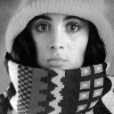

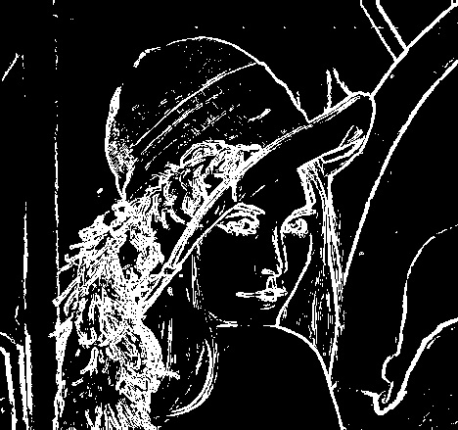
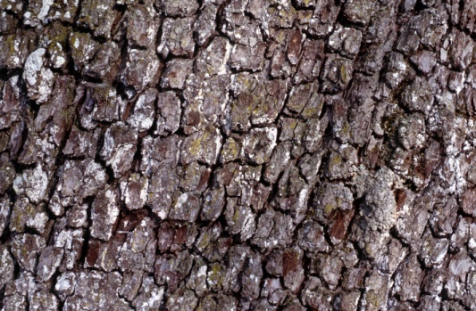
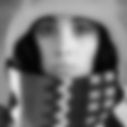
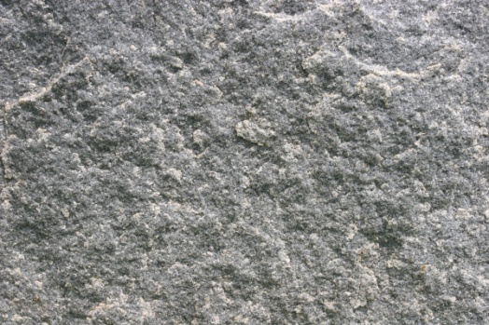
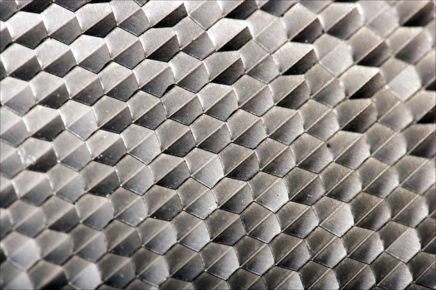
Features and filters
Transforming and describing images; textures, colors, edges
Slide credit: Kristen Grauman

Slide 3
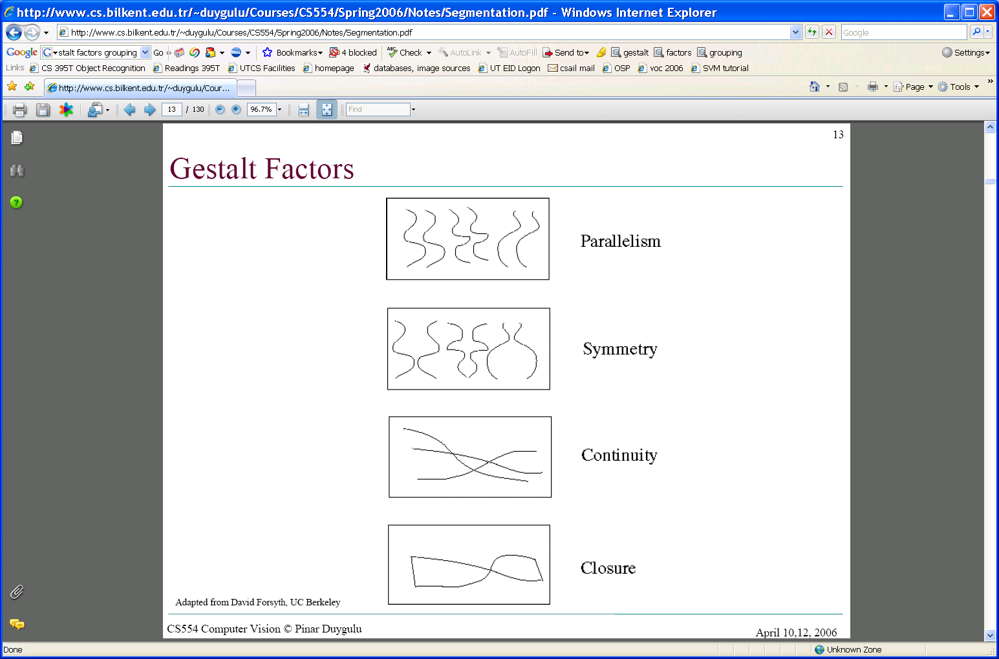
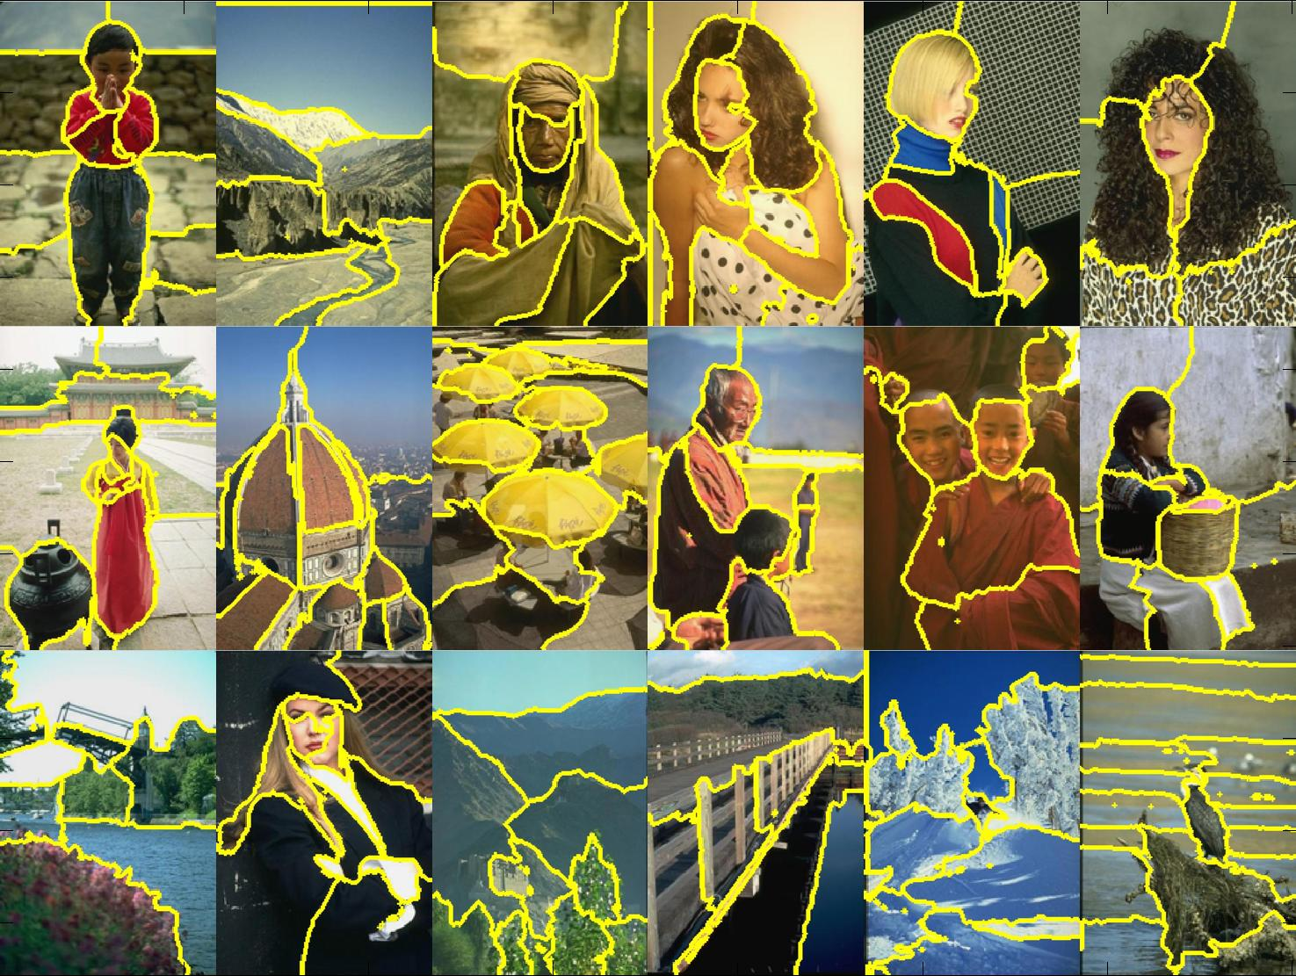
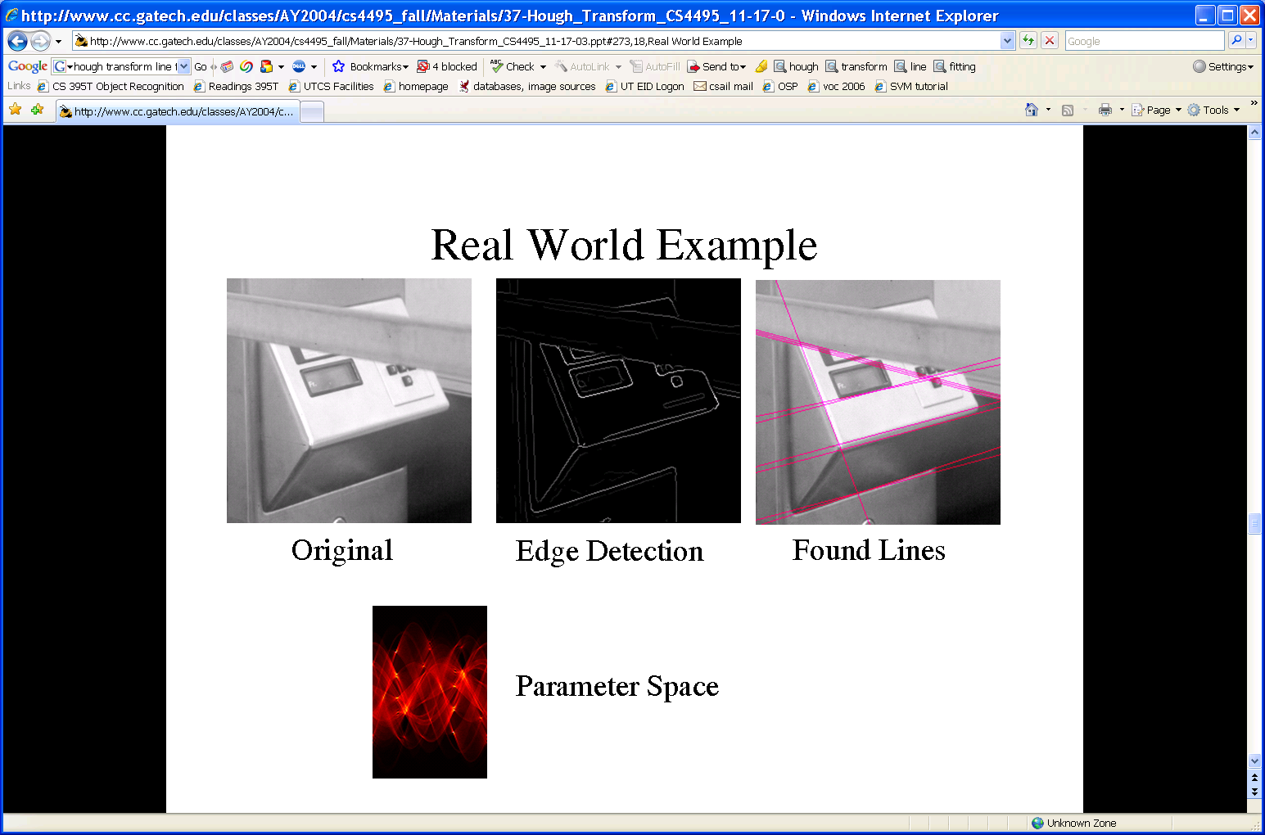
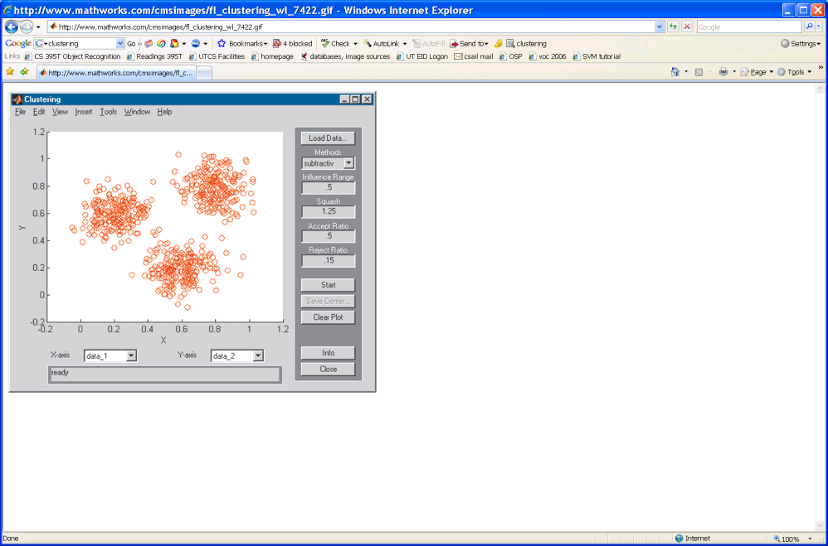
Grouping and fitting
Clustering, segmentation, fitting; what parts belong together?
[fig from Shi et al]
Slide credit: Kristen Grauman

Slide 4
Outline
What are grouping problems in vision?
Bottom-up segmentation via clustering
Algorithms:
Mode finding and mean shift: k-means, mean-shift
Graph-based: normalized cuts
Features: color, texture, …
Quantization for texture summaries
Slide credit: Kristen Grauman
Notes:
4

Slide 5
Grouping in vision
Goals:
Gather features that belong together
Obtain an intermediate representation that compactly describes key image or video parts
Slide credit: Kristen Grauman
Notes:
An important component of vision involves organizing image information into meaningful assemblies.

Slide 6
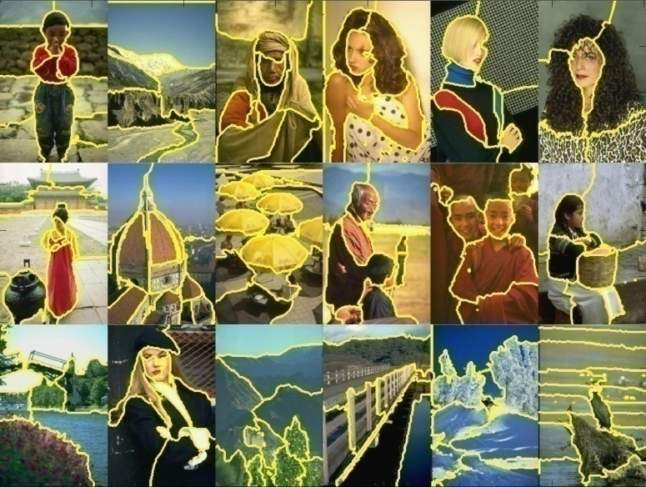
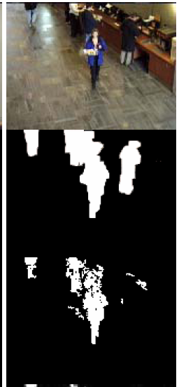
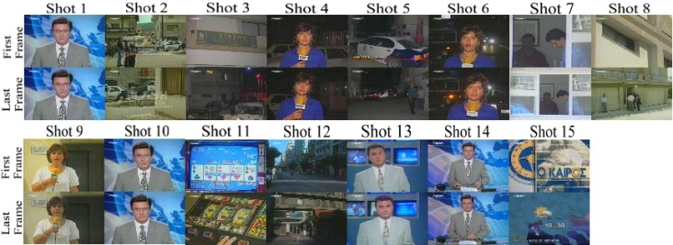
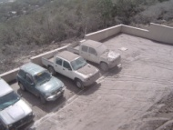
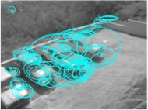
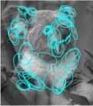
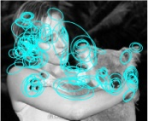

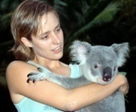
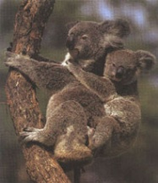
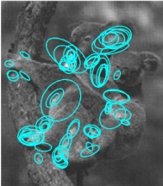
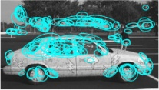

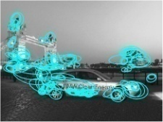



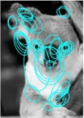
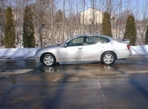
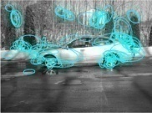

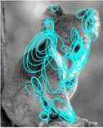
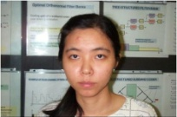
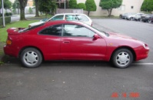
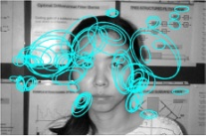
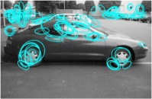
Examples of grouping in vision
[http://poseidon.csd.auth.gr/LAB_RESEARCH/Latest/imgs/SpeakDepVidIndex_img2.jpg]
Group video frames into shots
[Figure by J. Shi]
Determine image regions
Fg / Bg
[Figure by Wang & Suter]
Figure-ground
[Figure by Grauman & Darrell]
Object-level grouping
Slide credit: Kristen Grauman
Notes:
6

Slide 7
Grouping in vision
Goals:
Gather features that belong together
Obtain an intermediate representation that compactly describes key image (video) parts
Top down vs. bottom up segmentation
Top down: pixels belong together because they are from the same object
Bottom up: pixels belong together because they look similar
Hard to measure success
What is interesting depends on the app.
Slide credit: Kristen Grauman

Slide 8
Outline
Bottom-up segmentation via clustering
Algorithms:
Mode finding and mean shift: k-means, mean-shift
Graph-based: normalized cuts
Features: color, texture, …
Quantization for texture summaries
Slide credit: Kristen Grauman
Notes:
8

Slide 9
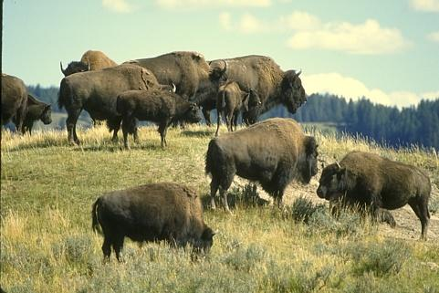
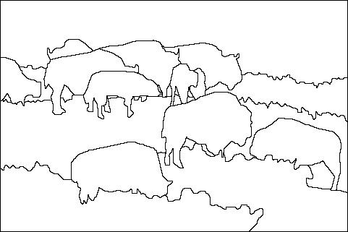
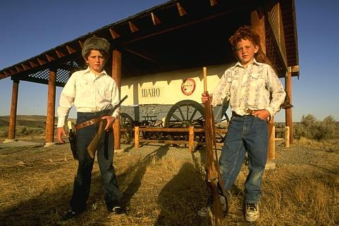
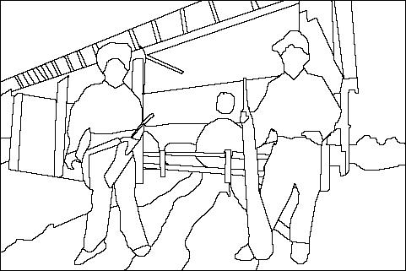
The goals of segmentation
Separate image into coherent “objects”
image
human segmentation
Source: Lana Lazebnik

Slide 10
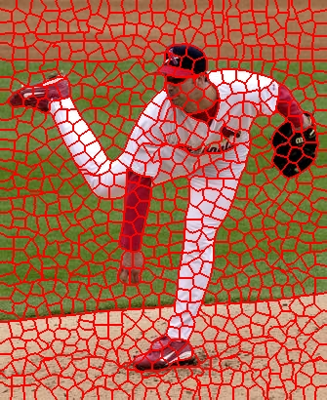
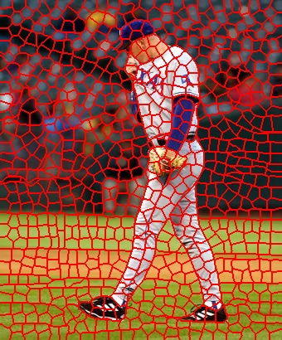
The goals of segmentation
Separate image into coherent “objects”
Group together similar-looking pixels for efficiency of further processing
“superpixels”
X. Ren and J. Malik. Learning a classification model for segmentation. ICCV 2003.
Source: Lana Lazebnik

Slide 11
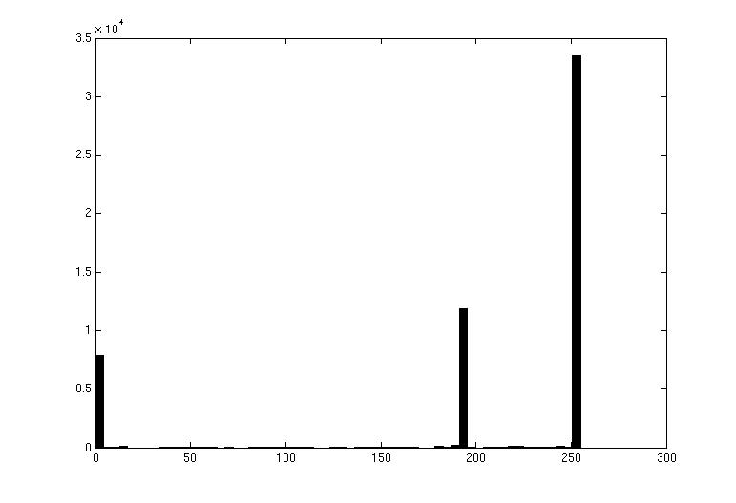

Image segmentation: toy example
white pixels
pixel count
3
black pixels
gray pixels
1
2
input image
intensity
These intensities define the three groups.
We could label every pixel in the image according to which of these primary intensities it is.
i.e., segment the image based on the intensity feature.
What if the image isn’t quite so simple?
Slide credit: Kristen Grauman

Slide 12
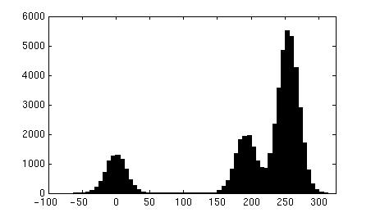
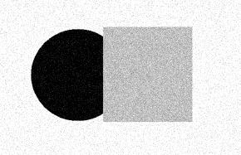
pixel count
input image
intensity
pixel count
input image
intensity
Slide credit: Kristen Grauman

Slide 13
pixel count
input image
intensity
Now how to determine the three main intensities that define our groups?
We need to cluster.
Slide credit: Kristen Grauman

Slide 14
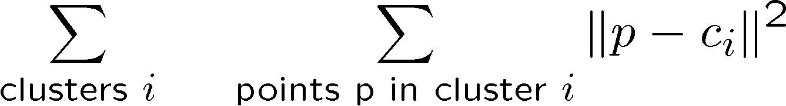
0
190
255
intensity
3
1
2
Goal: choose three “centers” as the representative intensities, and label every pixel according to which of these centers it is nearest to.
Best cluster centers are those that minimize SSD between all points and their nearest cluster center ci:
Slide credit: Kristen Grauman

Slide 15
Clustering
With this objective, it is a “chicken and egg” problem:
If we knew the cluster centers, we could allocate points to groups by assigning each to its closest center.
If we knew the group memberships, we could get the centers by computing the mean per group.
Slide credit: Kristen Grauman

Slide 16
K-means clustering
Basic idea: randomly initialize the k cluster centers, and iterate between the two steps we just saw.
Randomly initialize the cluster centers, c₁, ..., c_{K}
Given cluster centers, determine points in each cluster
For each point p, find the closest c_{i}. Put p into cluster i
Given points in each cluster, solve for c_{i}
Set c_{i} to be the mean of points in cluster i
If c_{i} have changed, repeat Step 2
Properties
Will always converge to some solution
Can be a “local minimum”
does not always find the global minimum of objective function:
Source: Steve Seitz

Slide 17
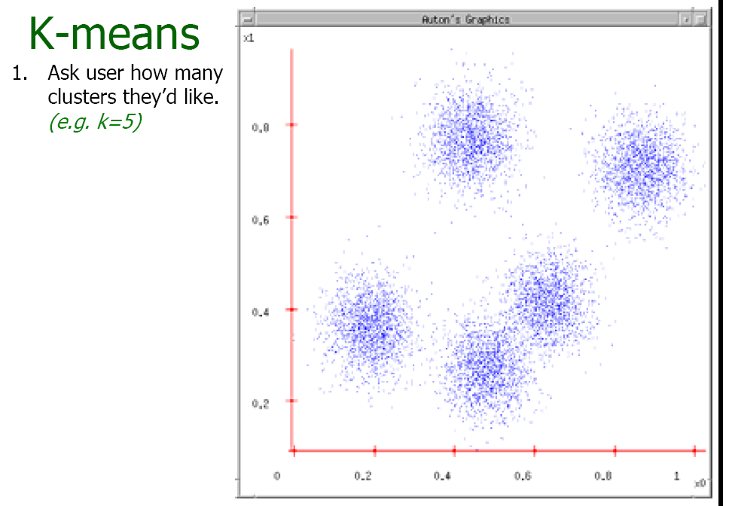
Andrew Moore

Slide 18
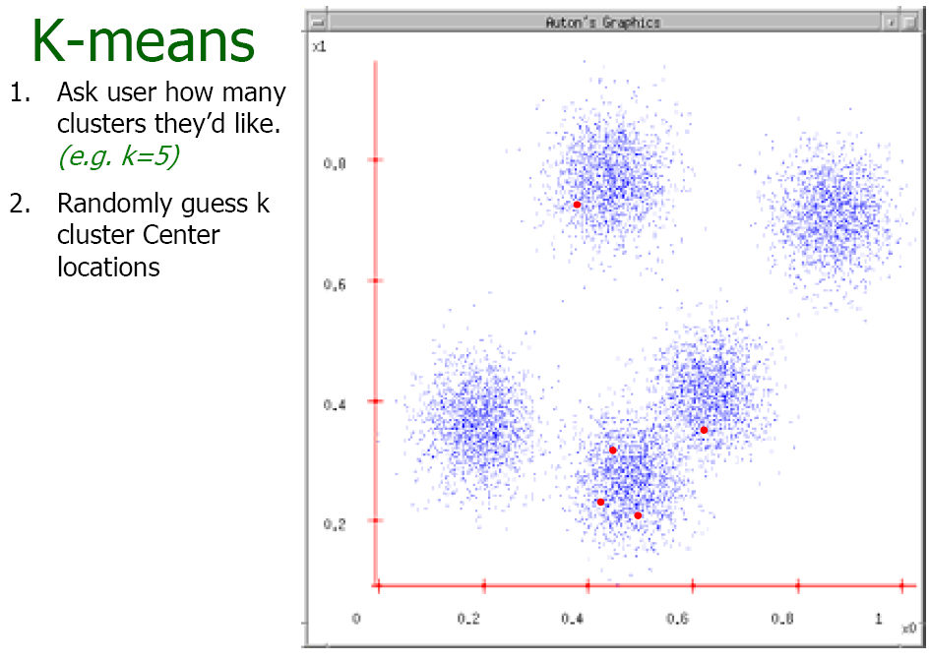
Andrew Moore

Slide 19
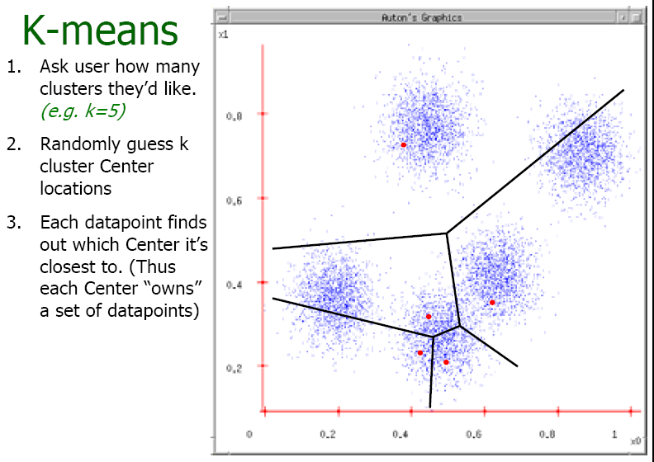
Andrew Moore

Slide 20
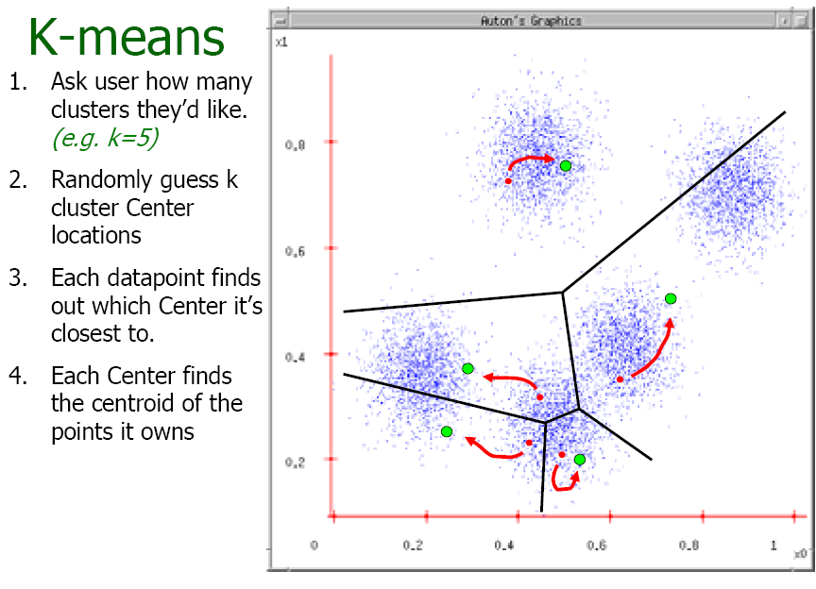
Andrew Moore

Slide 21
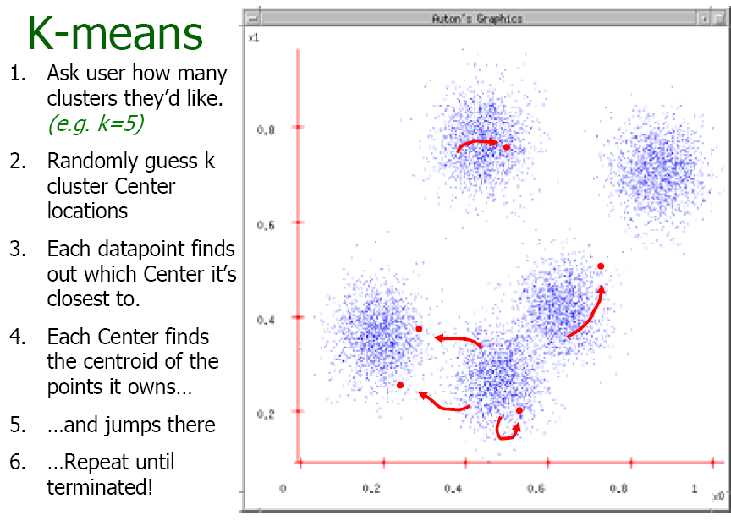
Andrew Moore

Slide 22
K-means clustering
Demo
http://home.dei.polimi.it/matteucc/Clustering/tutorial_html/AppletKM.html
Slide credit: Kristen Grauman

Slide 23
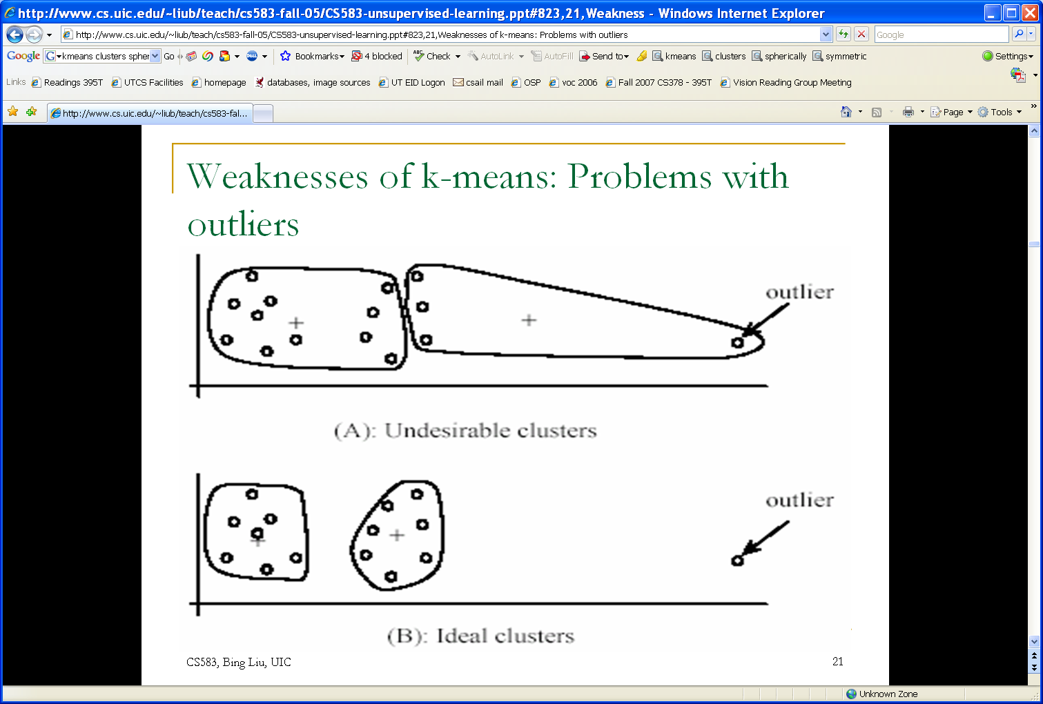
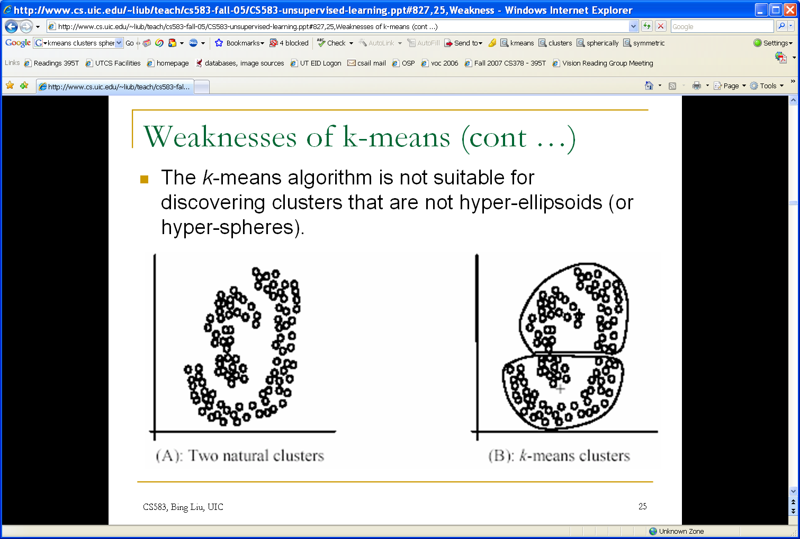
K-means: pros and cons
Pros
Simple, fast to compute
Converges to local minimum of within-cluster squared error
Cons/issues
Setting k?
Sensitive to initial centers
Sensitive to outliers
Detects spherical clusters
Assuming means can be computed
Slide credit: Kristen Grauman
Notes:
23

Slide 24
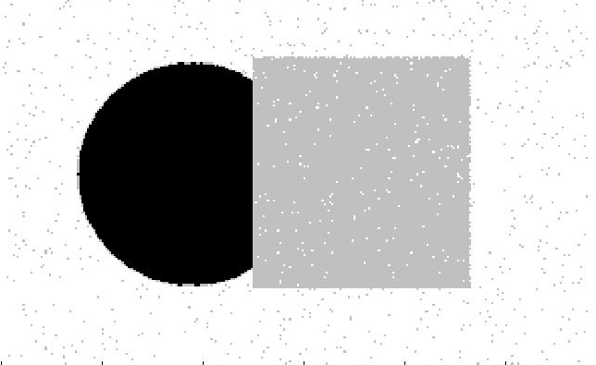
An aside: Smoothing out cluster assignments
Assigning a cluster label per pixel may yield outliers:
original
labeled by cluster center’s intensity
?
How to ensure they are spatially smooth?
3
1
2
Slide credit: Kristen Grauman

Slide 25
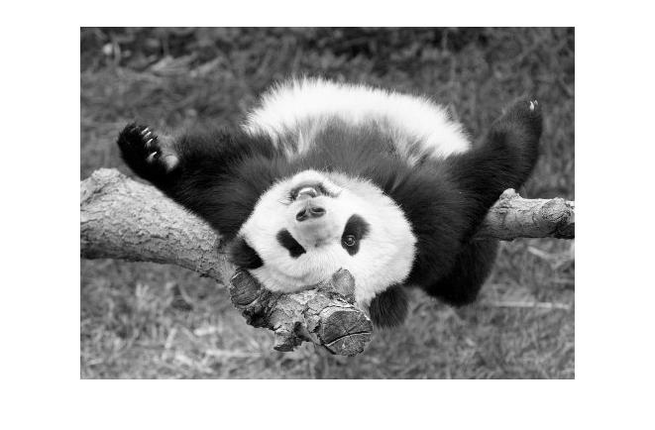
Segmentation as clustering
Depending on what we choose as the feature space, we can group pixels in different ways.
Grouping pixels based on intensity similarity
Feature space: intensity value (1-d)
Slide credit: Kristen Grauman
Notes:
25

Slide 26
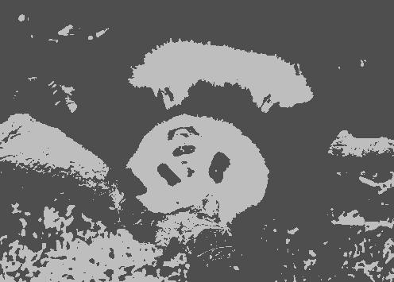

K=2
K=3
quantization of the feature space; segmentation label map
Slide credit: Kristen Grauman

Slide 27

Segmentation as clustering
Depending on what we choose as the feature space, we can group pixels in different ways.
R=255
G=200
B=250
Grouping pixels based on color similarity
B
R=245
G=220
B=248
G
R=15
G=189
B=2
R=3
G=12
B=2
R
Feature space: color value (3-d)
Slide credit: Kristen Grauman
Notes:
27

Slide 28
Segmentation as clustering
Depending on what we choose as the feature space, we can group pixels in different ways.
Grouping pixels based on intensity similarity
Clusters based on intensity similarity don’t have to be spatially coherent.
Slide credit: Kristen Grauman
Notes:
28

Slide 29
Segmentation as clustering
Depending on what we choose as the feature space, we can group pixels in different ways.
Grouping pixels based on intensity+position similarity
Intensity
Y
X
Both regions are black, but if we also include position (x,y), then we could group the two into distinct segments; way to encode both similarity & proximity.
Slide credit: Kristen Grauman
Notes:
29

Slide 30



Segmentation as clustering
Color, brightness, position alone are not enough to distinguish all regions…
Slide credit: Kristen Grauman

Slide 31

Segmentation as clustering
Depending on what we choose as the feature space, we can group pixels in different ways.
Grouping pixels based on texture similarity
F₁
F₂
Filter bank of 24 filters
…
F₂₄
Feature space: filter bank responses (e.g., 24-d)
Slide credit: Kristen Grauman
Notes:
31

Slide 32

Recall: texture representation example
 | mean d/dx value | mean d/dy value
Win. #1 | 4 | 10
Win.#2 | 18 | 7
Win.#9 | 20 | 20
original image
…
…
statistics to summarize patterns in small windows
derivative filter responses, squared
Slide credit: Kristen Grauman

Slide 33
Recall: texture representation example
Windows with primarily horizontal edges
Both
 | mean d/dx value | mean d/dy value
Win. #1 | 4 | 10
Win.#2 | 18 | 7
Win.#9 | 20 | 20
Dimension 2 (mean d/dy value)
Dimension 1 (mean d/dx value)
…
…
Windows with small gradient in both directions
Windows with primarily vertical edges
statistics to summarize patterns in small windows
Slide credit: Kristen Grauman
Notes:
33

Slide 34

Image segmentation example
Slide credit: Kristen Grauman

Slide 35


Color vs. texture
These look very similar in terms of their color distributions (histograms).
How would their texture distributions compare?
Slide credit: Kristen Grauman

Slide 36
Outline
What are grouping problems in vision?
Bottom-up segmentation via clustering
Algorithms:
Mode finding and mean shift: k-means, mean-shift
Graph-based: normalized cuts
Features: color, texture, …
Quantization for texture summaries
Slide credit: Kristen Grauman
Notes:
36

Slide 37
K-means: pros and cons
Pros
Simple, fast to compute
Converges to local minimum of within-cluster squared error
Cons/issues
Setting k?
Sensitive to initial centers
Sensitive to outliers
Detects spherical clusters
Assuming means can be computed
Slide credit: Kristen Grauman
Notes:
37

Slide 38

Mean shift algorithm
The mean shift algorithm seeks modes or local maxima of density in the feature space
Feature space
(L*u*v* color values)
image
Slide credit: Kristen Grauman

Slide 39
Mean shift
Search window
Center of
mass
Mean Shift
vector
Slide by Y. Ukrainitz & B. Sarel

Slide 40
Mean shift
Search window
Center of
mass
Mean Shift
vector
Slide by Y. Ukrainitz & B. Sarel

Slide 41
Mean shift
Search window
Center of
mass
Mean Shift
vector
Slide by Y. Ukrainitz & B. Sarel

Slide 42
Mean shift
Search window
Center of
mass
Mean Shift
vector
Slide by Y. Ukrainitz & B. Sarel

Slide 43
Mean shift
Search window
Center of
mass
Mean Shift
vector
Slide by Y. Ukrainitz & B. Sarel

Slide 44
Mean shift
Search window
Center of
mass
Mean Shift
vector
Slide by Y. Ukrainitz & B. Sarel

Slide 45
Mean shift
Search window
Center of
mass
Slide by Y. Ukrainitz & B. Sarel

Slide 46

Mean shift clustering
Cluster: all data points in the attraction basin of a mode
Attraction basin: the region for which all trajectories lead to the same mode
Slide by Y. Ukrainitz & B. Sarel

Slide 47

Mean shift clustering/segmentation
Find features (color, gradients, texture, etc)
Initialize windows at individual feature points
Perform mean shift for each window until convergence
Merge windows that end up near the same “peak” or mode
Slide credit: Kristen Grauman

Slide 48




Mean shift segmentation results
http://www.caip.rutgers.edu/~comanici/MSPAMI/msPamiResults.html
Slide credit: Kristen Grauman
Notes:
Color + position

Slide 49

Mean shift segmentation results
Slide credit: Kristen Grauman

Slide 50
Mean shift
Pros:
Does not assume shape on clusters
One parameter choice (window size)
Generic technique
Find multiple modes
Cons:
Selection of window size
Does not scale well with dimension of feature space
Slide credit: Kristen Grauman

Slide 51
Outline
What are grouping problems in vision?
Bottom-up segmentation via clustering
Algorithms:
Mode finding and mean shift: k-means, mean-shift
Graph-based: normalized cuts
Features: color, texture, …
Quantization for texture summaries
Slide credit: Kristen Grauman
Notes:
51

Slide 52

Images as graphs
q
w_{pq}
w
p
Fully-connected graph
node (vertex) for every pixel
link between every pair of pixels, p,q
affinity weight w_{pq} for each link (edge)
w_{pq} measures similarity
similarity is inversely proportional to difference (in color and position…)
Source: Steve Seitz

Slide 53


Measuring affinity
One possibility:
Small sigma: group only nearby points
Large sigma: group distant points
Slide credit: Kristen Grauman

Slide 54

Measuring affinity
σ=.2
Data points
Affinity matrices
σ=.1 σ=.2 σ=1
Slide credit: Kristen Grauman

Slide 55
Segmentation by Graph Cuts
q
w_{pq}
w
p
A
B
C
Break Graph into Segments
Want to delete links that cross between segments
Easiest to break links that have low similarity (low weight)
similar pixels should be in the same segments
dissimilar pixels should be in different segments
Source: Steve Seitz

Slide 56
Cuts in a graph: Min cut
B
A
Link Cut
set of links whose removal makes a graph disconnected
cost of a cut:
Find minimum cut
gives you a segmentation
fast algorithms exist for doing this
Source: Steve Seitz

Slide 57

Minimum cut
Problem with minimum cut:
Weight of cut proportional to number of edges in the cut; tends to produce small, isolated components.
[Shi & Malik, 2000 PAMI]
Slide credit: Kristen Grauman

Slide 58

Cuts in a graph: Normalized cut
B
A
Normalized Cut
fix bias of Min Cut by normalizing for size of segments:
assoc(A,V) = sum of weights of all edges that touch A
Ncut value small when we get two clusters with many edges with high weights, and few edges of low weight between them
Approximate solution for minimizing the Ncut value : generalized eigenvalue problem.
J. Shi and J. Malik, Normalized Cuts and Image Segmentation, CVPR, 1997
Source: Steve Seitz

Slide 59









Example results
Slide credit: Kristen Grauman

Slide 60









Results: Berkeley Segmentation Engine
http://www.cs.berkeley.edu/~fowlkes/BSE/
Slide credit: Kristen Grauman

Slide 61
Normalized cuts: pros and cons
Pros:
Generic framework, flexible to choice of function that computes weights (“affinities”) between nodes
Does not require model of the data distribution
Cons:
Time complexity can be high
Dense, highly connected graphs → many affinity computations
Solving eigenvalue problem
Preference for balanced partitions
Slide credit: Kristen Grauman

Slide 62




Efficient graph-based segmentation
Runs in time nearly linear in the number of edges
Easy to control coarseness of segmentations
Results can be unstable
P. Felzenszwalb and D. Huttenlocher, Efficient Graph-Based Image Segmentation, IJCV 2004

Slide 63




Segmentation for efficiency: “superpixels”
[Felzenszwalb and Huttenlocher 2004]
[Shi and Malik 2001]
[Hoiem et al. 2005, Mori 2005]

Slide 64

Segmentation for object proposals
“Selective Search” [Sande, Uijlings et al. ICCV 2011, IJCV 2013]
[Endres Hoiem ECCV 2010, IJCV 2014]

Slide 65

Segmentation for object proposals
Multiple segmentations
B. Russell et al., “Using Multiple Segmentations to Discover Objects and their Extent in Image Collections,” CVPR 2006
Slide credit: Lana Lazebnik

Slide 66






Motion segmentation
Input sequence
Image Segmentation
Motion Segmentation
Input sequence
Image Segmentation
Motion Segmentation
Barbu, S.C. Zhu. Generalizing Swendsen-Wang to sampling arbitrary posterior probabilities, IEEE Trans. PAMI, August 2005.
Slide credit: Kristen Grauman

Slide 67






Top-down segmentation
E. Borenstein and S. Ullman, “Class-specific, top-down segmentation,” ECCV 2002
A. Levin and Y. Weiss, “Learning to Combine Bottom-Up and Top-Down Segmentation,” ECCV 2006.
Slide credit: Lana Lazebnik

Slide 68

Top-down segmentation
Normalized cuts
Top-down segmentation
E. Borenstein and S. Ullman, “Class-specific, top-down segmentation,” ECCV 2002
A. Levin and Y. Weiss, “Learning to Combine Bottom-Up and Top-Down Segmentation,” ECCV 2006.
Slide credit: Lana Lazebnik

Slide 69
Summary
Segmentation to find object boundaries or mid-level regions, tokens.
Bottom-up segmentation via clustering
General choices -- features, affinity functions, and clustering algorithms
Grouping also useful for quantization, can create new feature summaries
Texton histograms for texture within local region
Example clustering methods
K-means
Mean shift
Graph cut, normalized cuts
Slide credit: Kristen Grauman

Slide 70

Coming up
Fitting
Slide credit: Adapted from Kristen Grauman

